Slide 1
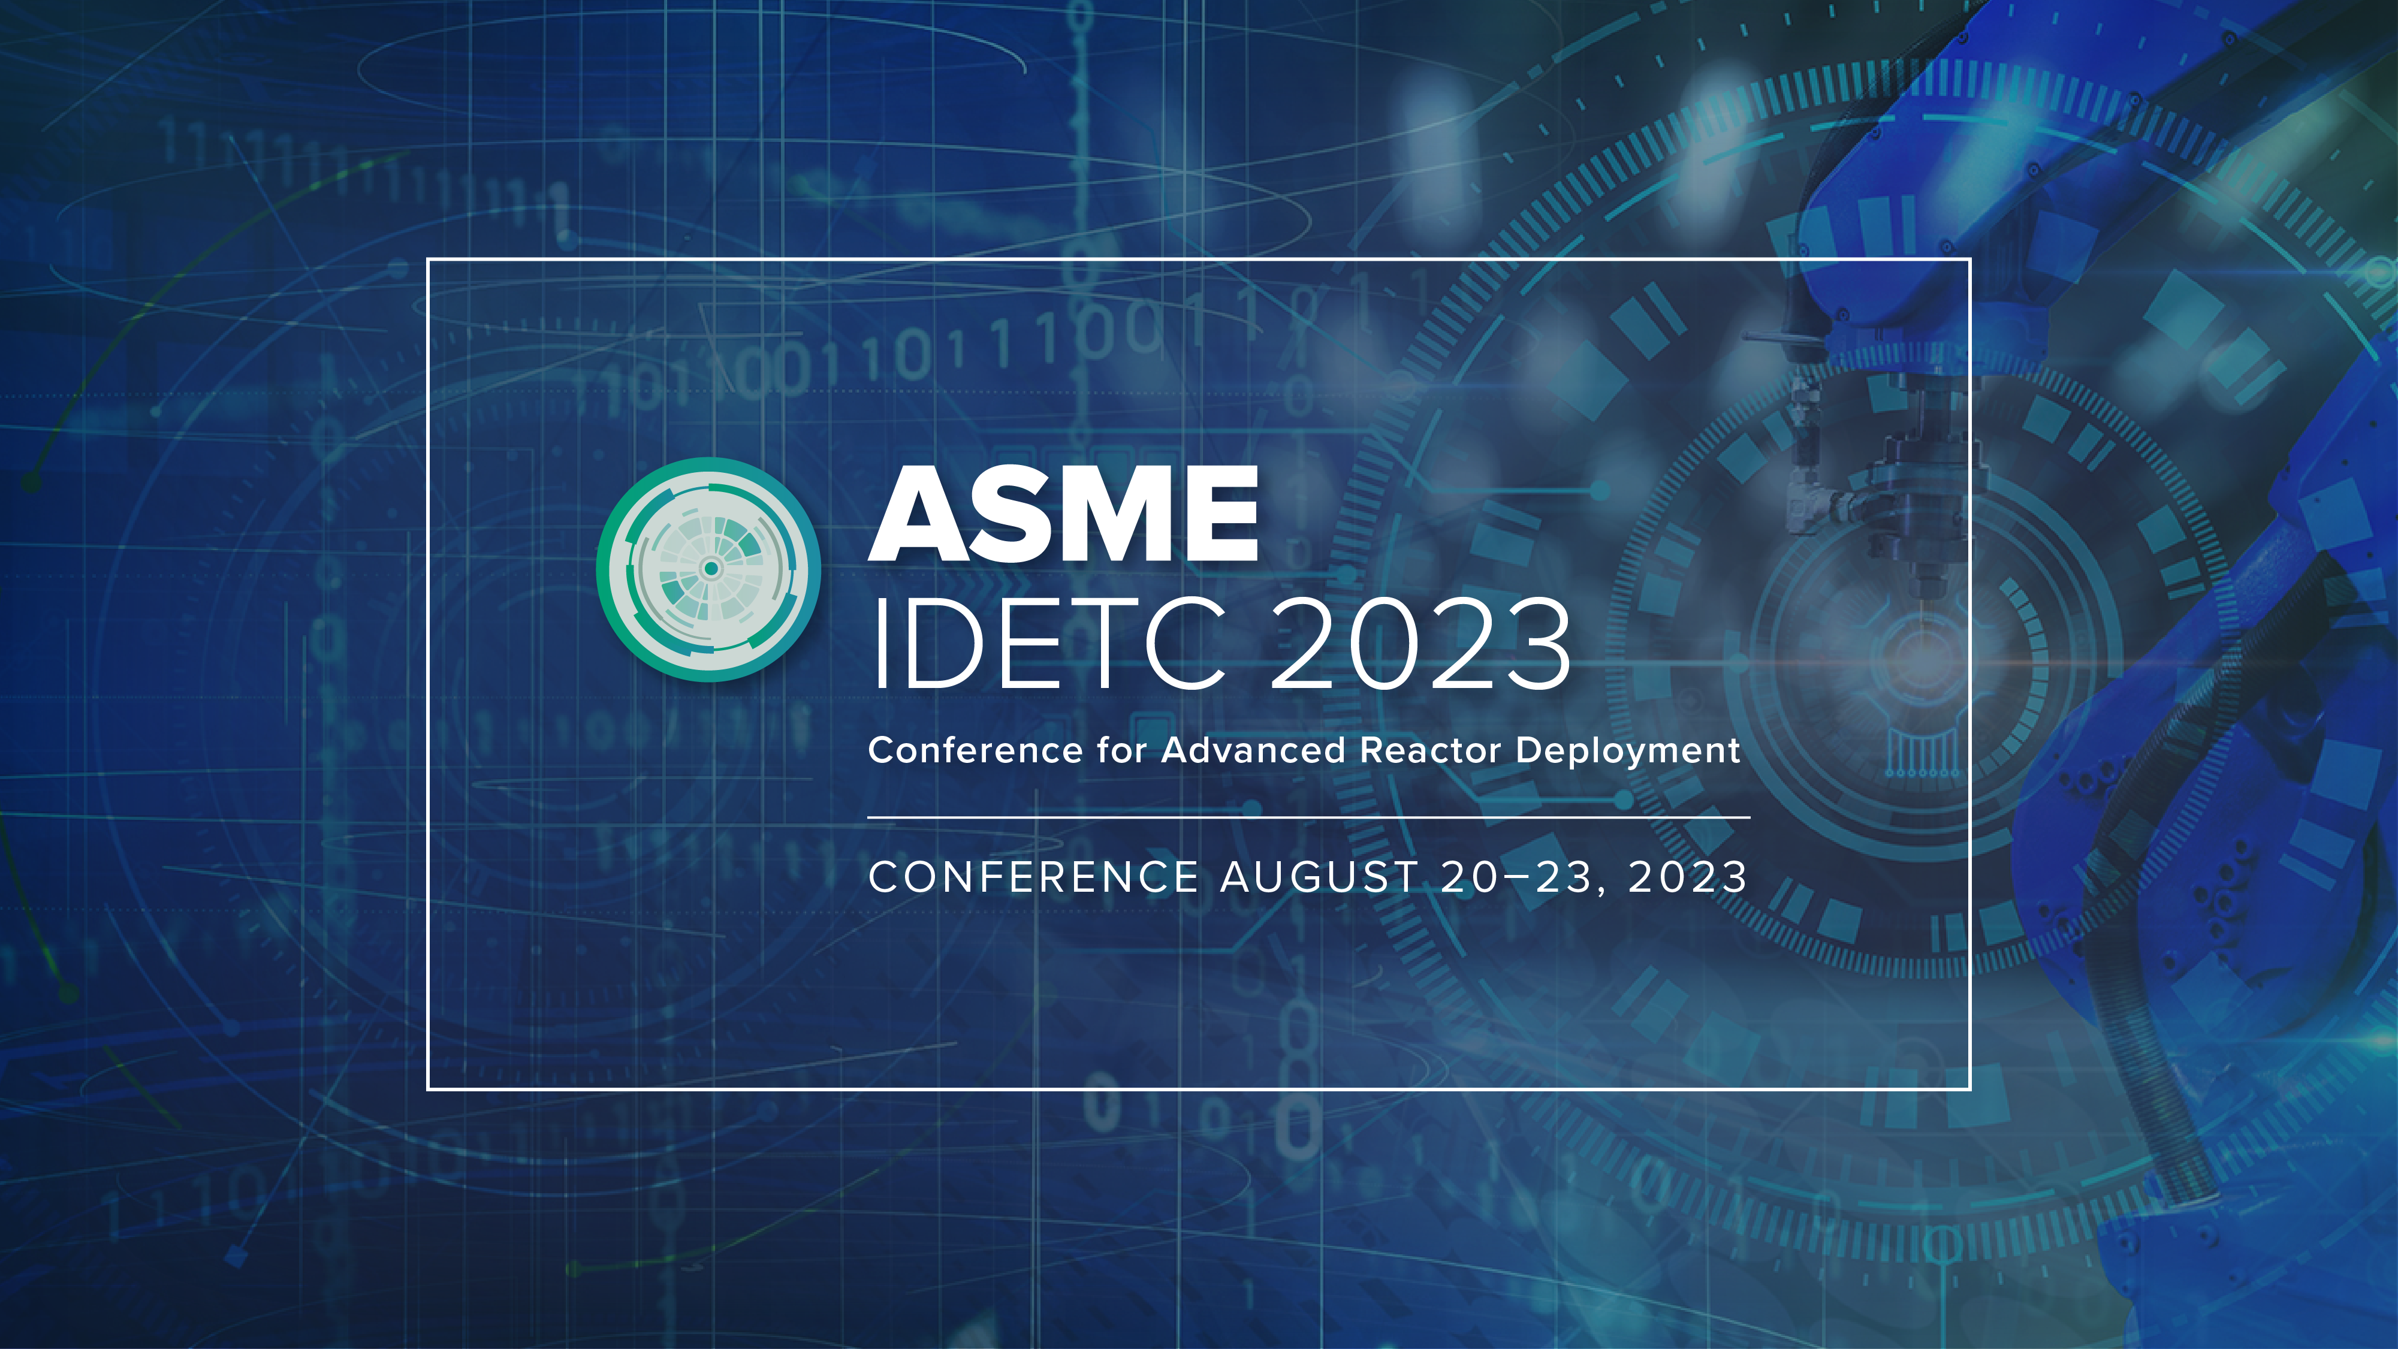
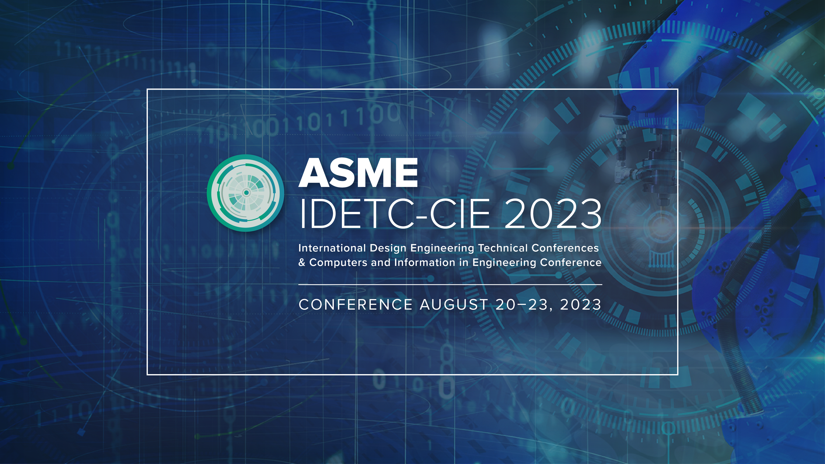


Slide 2


ASME IDETC2023 Hackathon:
Automating Material Selection for Product Design
Lequn Chen
Contact: chen1470@e.ntu.edu.sg
Advanced Remanufacturing and Technology Centre (ARTC), A*STAR, Singapore
Nanyang Technological University, Singapore
Notes:
Good afternoon, professors, and distinguished guests. My name is Lequn, and I am a PhD candidate from Nanyang Technological University. Today, I’m glad to present my paper, "Multimodal Sensor Fusion For Real-time Location-dependent Defect Detection In Laser-directed Energy Deposition"

Slide 3
01
Dataset Analysis
02
Methodology
CONTENTS
03
Results and Discussion
04
Future Works
Notes:
My presentation will follow this outline: introduction and background information, including the research gaps and objectives, the proposed methodologies and preliminary results and discussions, and future research directions.

Slide 4
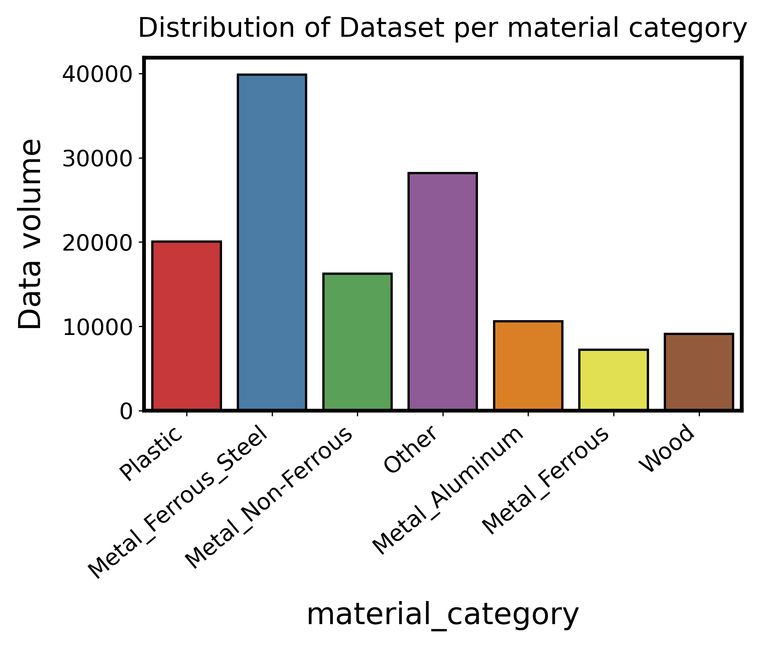
1. Dataset Analysis
Notes:
Dataset is imbalanced
Need to consider this factor during the modelling process.

Slide 5
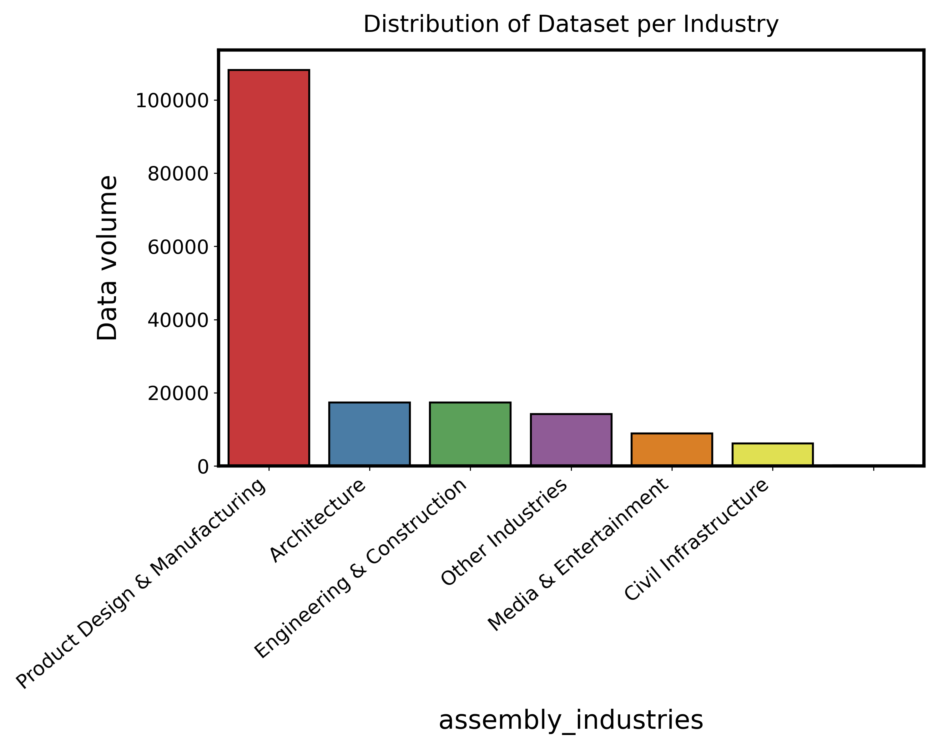
1. Dataset Analysis

Slide 6
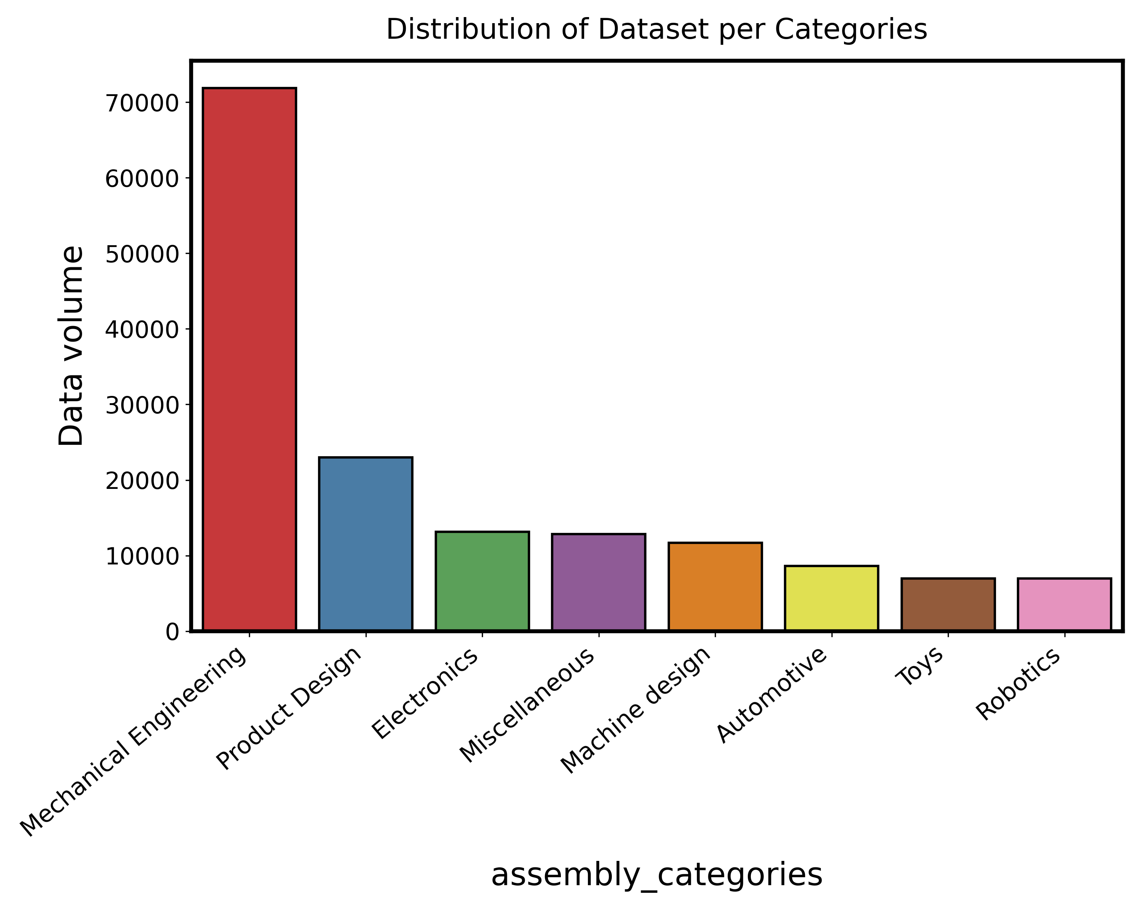
1. Dataset Analysis

Slide 7
1. Dataset Analysis
Notes:
Missing data exist assembly density

Slide 8
2. Feature Engineering
Physical Properties: Area, mass, density, and moments of inertia (xx, yy, zz, xy, yz, xz), etc; Different materials will have distinct densities and mass distributions.
Geometry Information:
- Bounding Box Dimensions
- Vertex count, Edge count, Face count, Loop count, Shell count, Body count: These counts can give an idea about the complexity of the geometry.
- Surface Types: The types of surfaces (e.g., cylindrical, planar, toroidal) and their counts can provide insights into the manufacturing processes suitable for the part, which in turn might hint at the material.
Design Information:
- Design Type: Whether the design is parametric, or some other type might influence material choice.
Metrics: While these metrics (likes, comments, views) might not directly influence the material, they might correlate with certain material choices (popularity) if popular designs tend to use specific materials.
Notes:
A breakdown of potentially useful information:
1. Physical Properties: The physical properties of the body, such as mass, density, and moments of inertia, can be informative. Different materials will have distinct densities and mass distributions.
- Area
- Volume
- Density
- Mass
- Moments of Inertia (xx, yy, zz, xy, yz, xz)
2. **Geometry Information**: The geometric complexity and shape of a part can sometimes hint at the material. For instance, intricate geometries might be made of materials that are easy to mold or machine.
- Bounding Box Dimensions: The difference between the max and min points on each axis can give the size in x, y, and z directions.
- Vertex count, Edge count, Face count, Loop count, Shell count, Body count: These counts can give an idea about the complexity of the geometry.
- Surface Types: The types of surfaces (e.g., cylindrical, planar, toroidal) and their counts can provide insights into the manufacturing processes suitable for the part, which in turn might hint at the material.
3. **Design Information**:
- Design Type: Whether the design is parametric or some other type might influence material choice.
4. **Engagement Metrics**: While these metrics (likes, comments, views) might not directly influence the material, they might correlate with certain material choices if popular designs tend to use specific materials.
5. **Categories and Industries**: The industry and category the design is intended for can be a strong hint. For instance, designs in the "Aerospace" industry might prefer lightweight and strong materials like titanium or composite materials.
6. **Derived Features**: Some features can be derived from the existing data to enhance its expressiveness. For instance:
- **Aspect Ratios**: Derived from the bounding box dimensions, they can indicate if a part is elongated, flat, or almost cubic, which might influence material choice.
- **Complexity Metrics**: Ratios like vertex-to-edge count, face-to-loop count, etc., can be indicative of the overall complexity of the design.
7. **Components and Hierarchical Structure**: The relationships between components can be meaningful. If certain sub-components are made of a specific material, it might influence the material choice of the main body. However, this requires a more complex modeling approach to take hierarchy into account.

Slide 9
2. Feature Engineering
Categories and Industries: The industry and category the design is intended for can be a strong hint. For instance, designs in the "Aerospace" industry might prefer lightweight and strong materials like titanium or composite materials.
Derived Features: Some features can be derived from the existing data to enhance its expressiveness. For instance:
- Aspect Ratios: Derived from the bounding box dimensions, they can indicate if a part is elongated, flat, or almost cubic, which might influence material choice.
- Complexity Metrics: Ratios like vertex-to-edge count, face-to-loop count, etc., can be indicative of the overall complexity of the design.
Components and Hierarchical Structure: The relationships between components can be meaningful. If certain sub-components are made of a specific material, it might influence the material choice of the main body. However, this requires a more complex modeling approach to take hierarchy into account. → potentially need to use knowledge graph to model the relationship

Slide 10
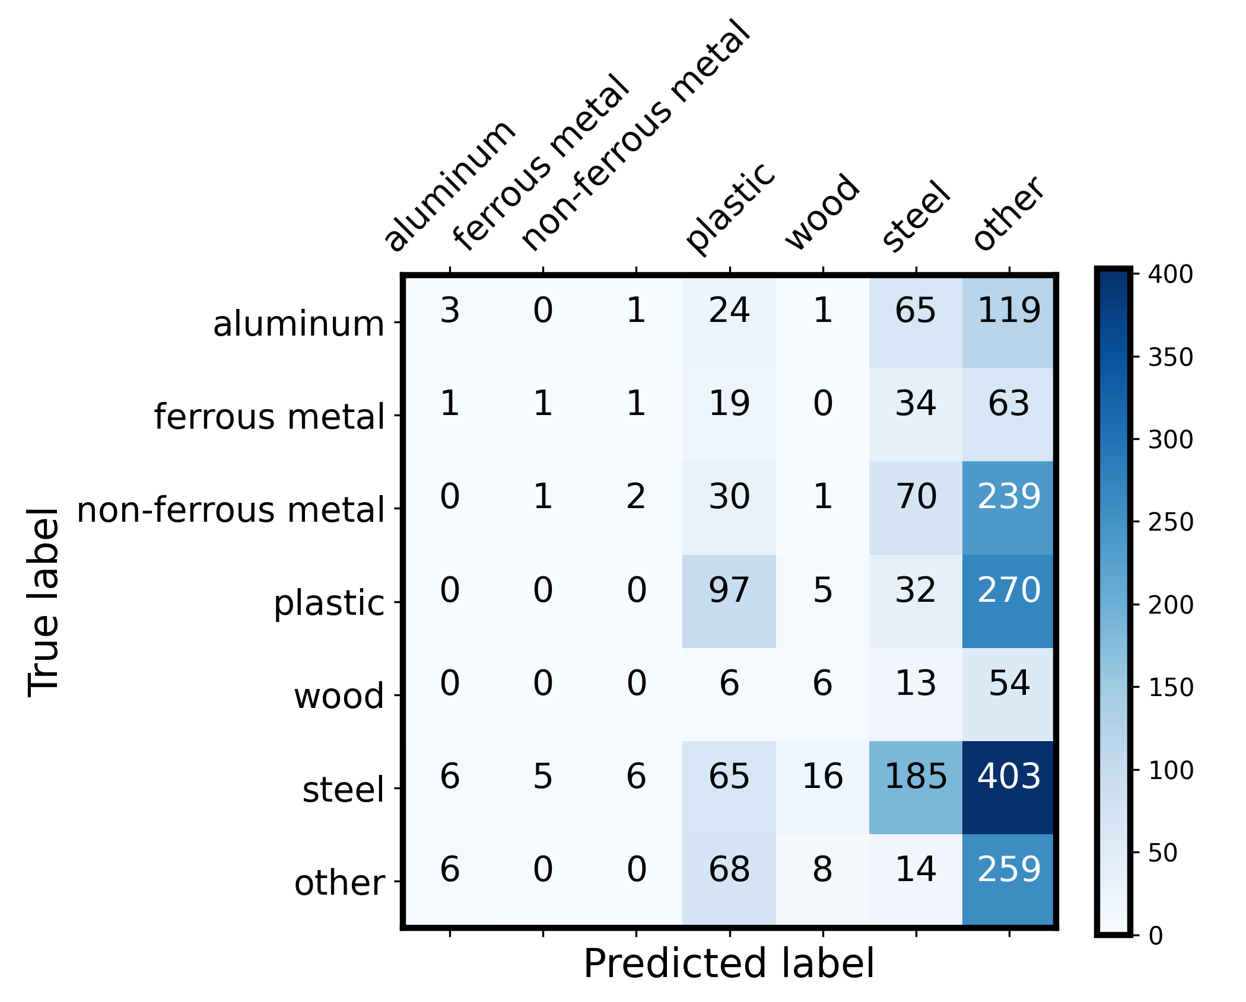
Baseline Model performance – GPT3.5 + only “name” feature

Slide 11







Thank you！
Q & A
Chen Lequn
PhD candidate
Advanced Remanufacturing and Technology Centre (ARTC), A*STAR, Singapore
School of Mechanical and Aerospace Engineering
Nanyang Technological University, Singapore
Contact: chen1470@e.ntu.edu.sg
Feel free to connect!

